Slide 1
Nabila Ahmed
Role: associate project Manager and biclass

Slide 2
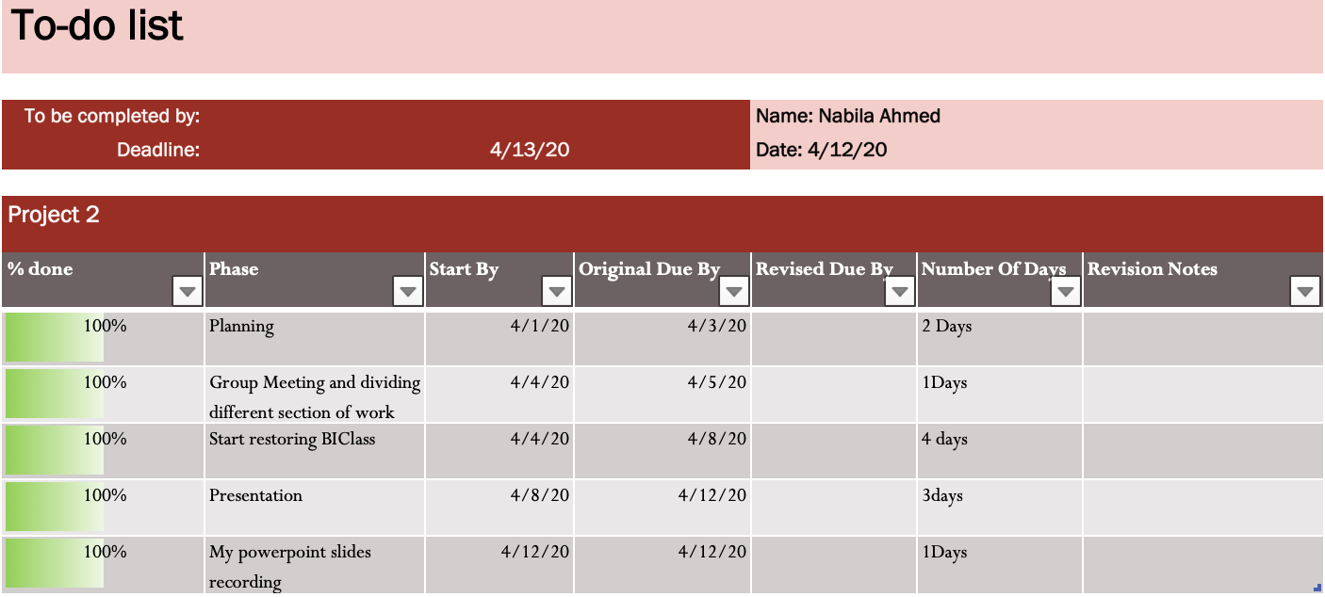
My TODO List

Slide 3
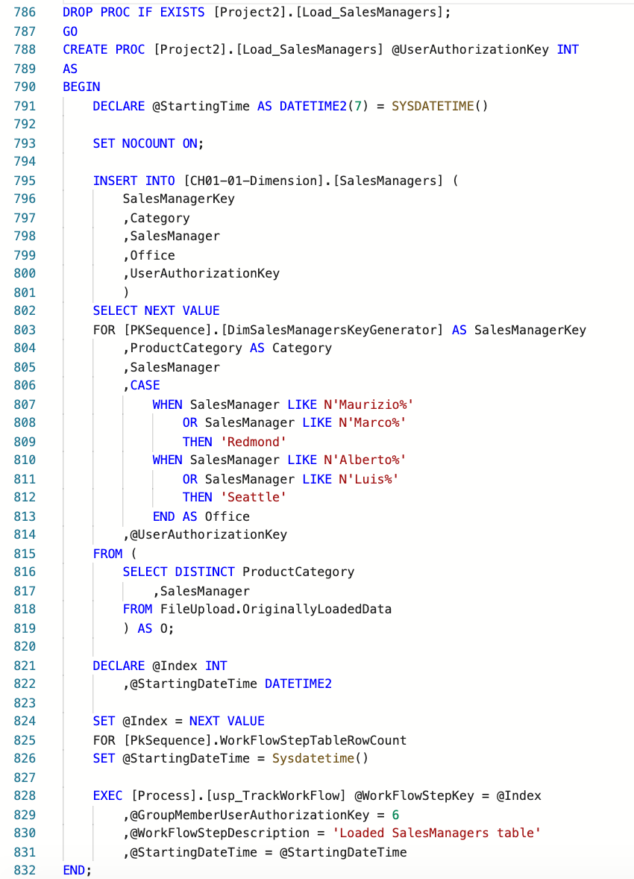
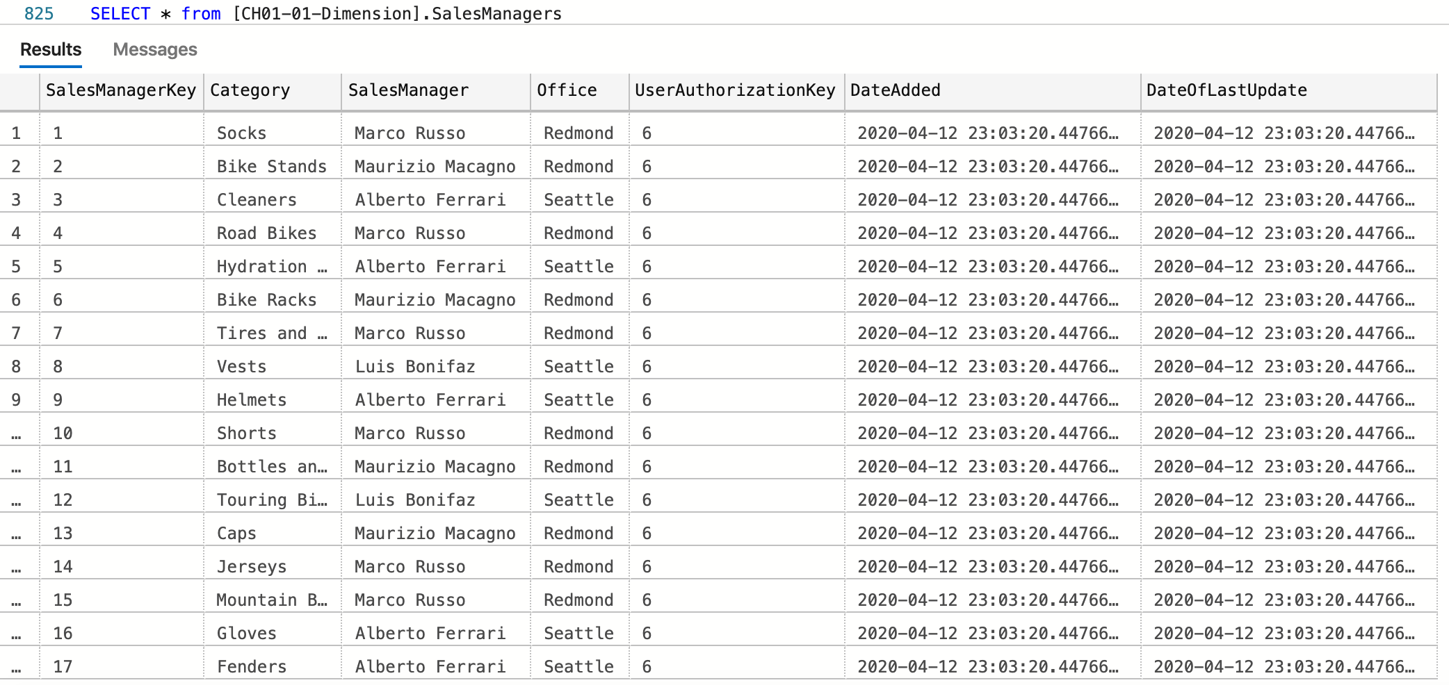
Created the SalesManager Table

Slide 4
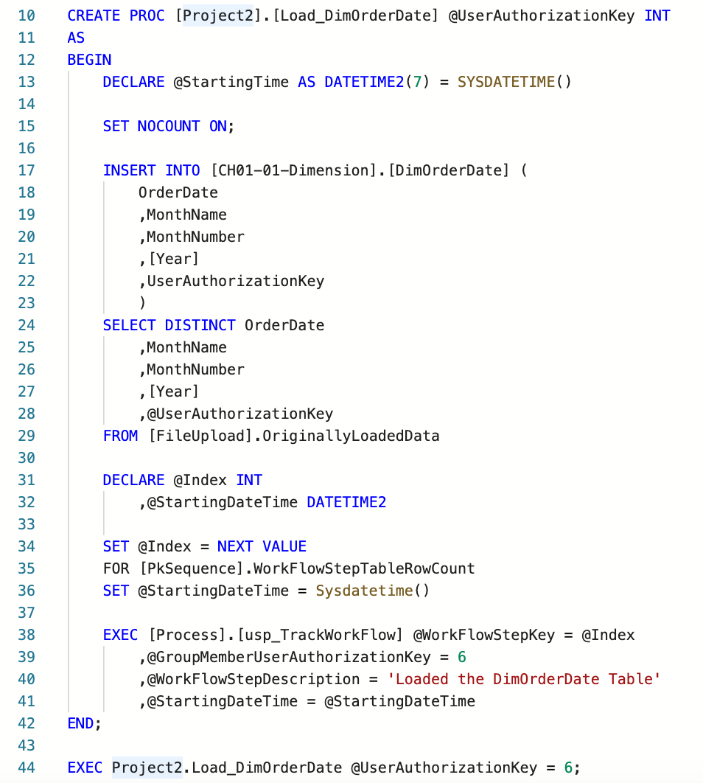
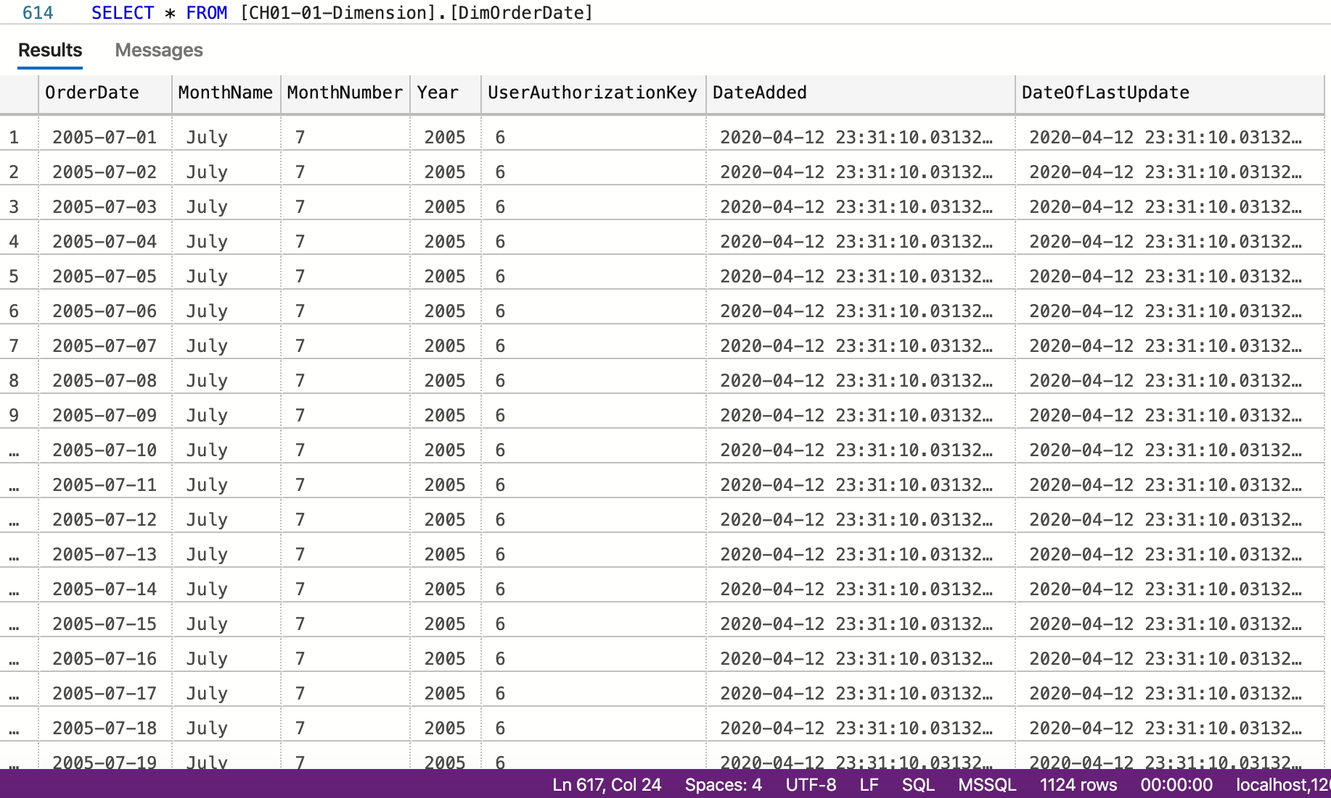
Created the DimOrderDate Table

